Slide 1
Intro to Data Science
Bel Kuhl

Slide 2
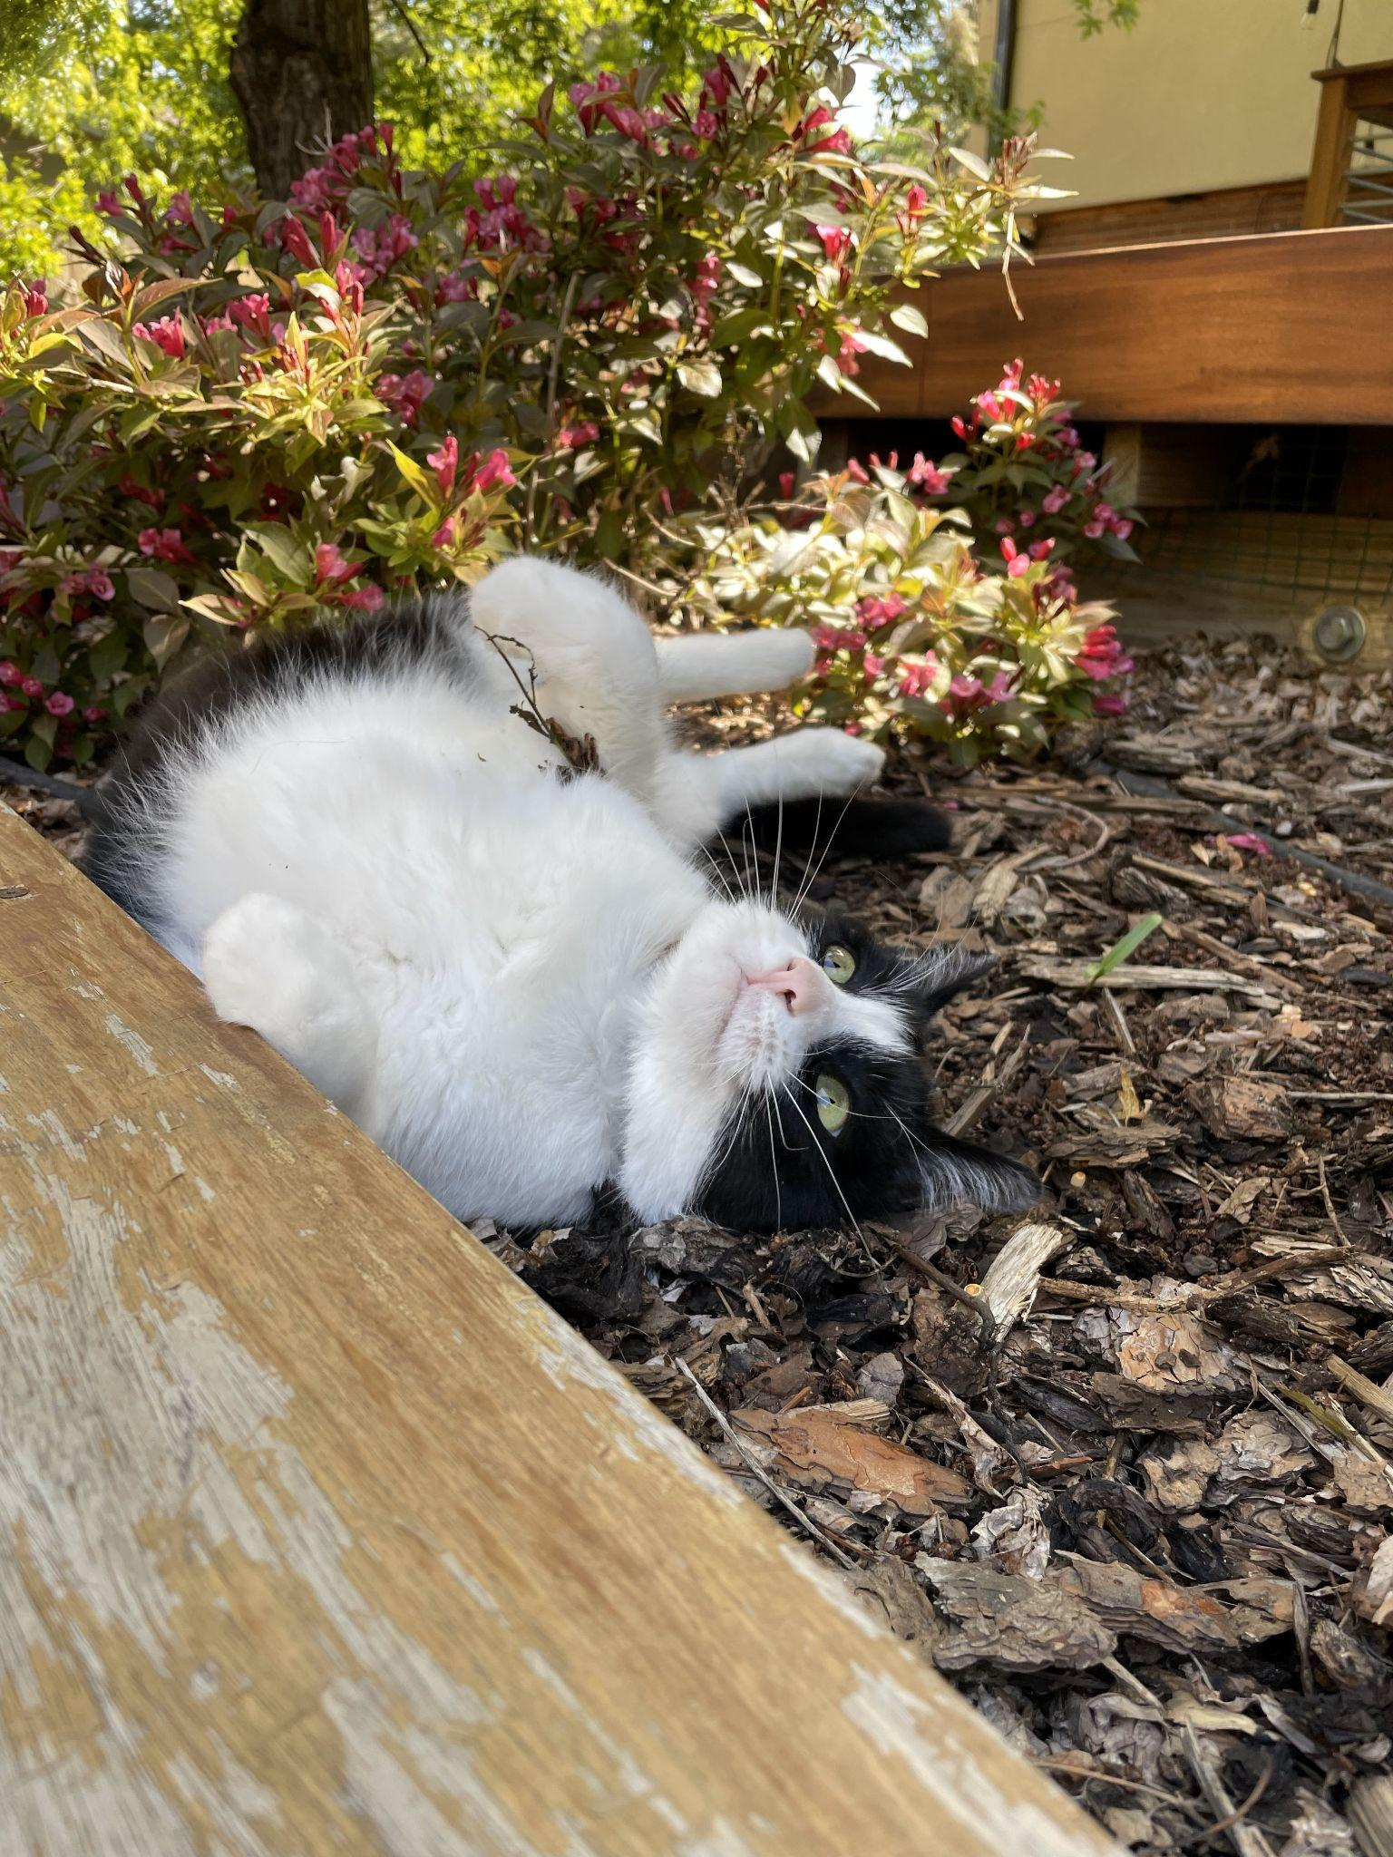
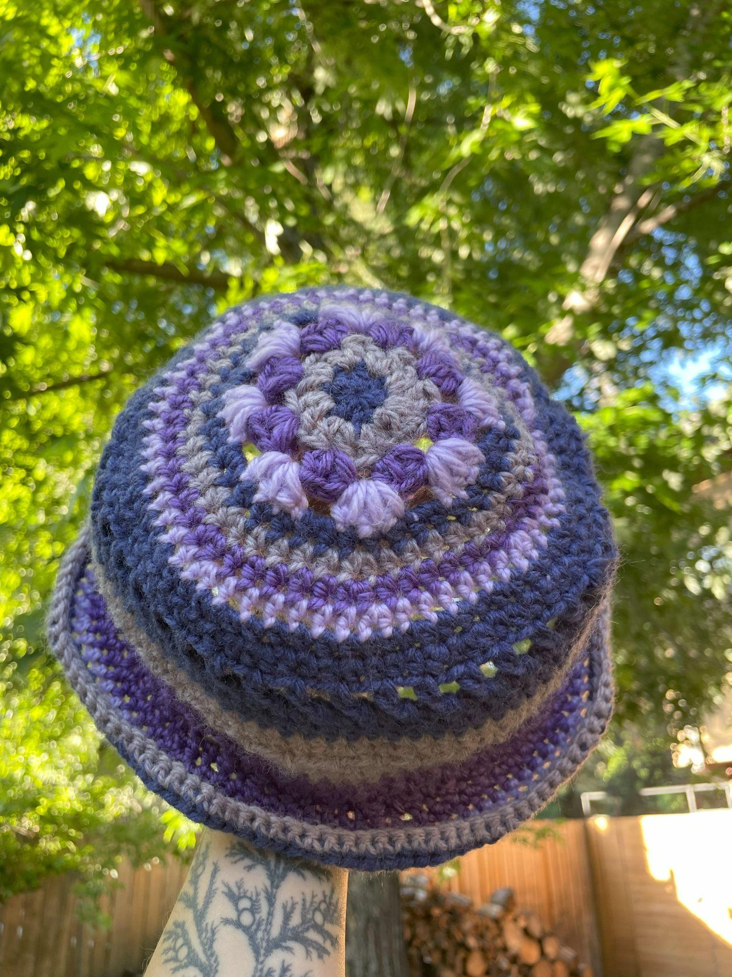
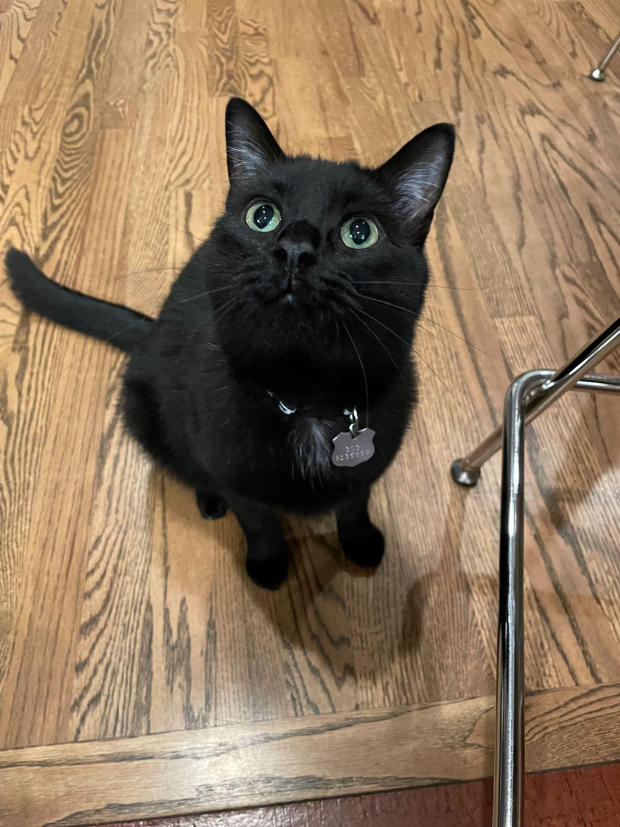
Who am I?
Bel Kuhl
Junior at Lewis & Clark College
Environmental Studies major

Slide 3


Why am I here?
Summer program
Worked with your teacher
Presenting our creation!

Slide 4
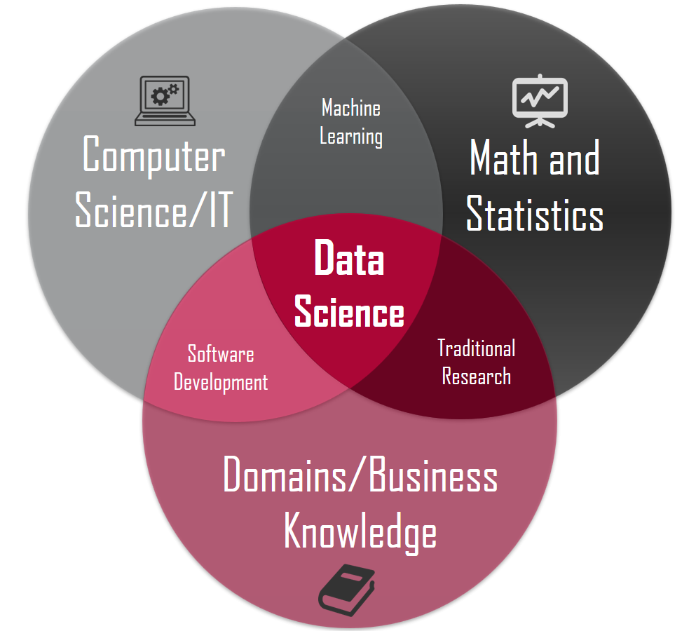
What is Data Science?
Combination of several fields
Focusing on coding
Brief introduction to R

